Slide 1
SUICIDE rate ANALySIS of INDIA

Slide 2
OBJECTIVE OF THE PROJECT
Prevention: One of the primary objectives is to identify risk factors and potential causes of suicide so that prevention strategies can be developed and implemented. Analyzing suicide rates can help identify high-risk groups and areas, allowing for targeted interventions and support.
Identifying Risk Factors: By analyzing suicide rates alongside various risk factors, such as mental health conditions, substance abuse, access to lethal means, and social determinants of health, researchers can gain insights into the complex interplay of factors contributing to suicide.
Raising Awareness: Publicizing suicide rate data can raise awareness about the importance of mental health and suicide prevention. It can also help reduce stigma surrounding mental health issues, making it more acceptable for individuals to seek help.

Slide 3
DATA SOURCE
National Health Agencies: National health agencies or ministries of health often collect and compile data on suicide rates. These agencies may rely on vital statistics data, hospital records, and other sources to create comprehensive reports. Eg-National Library of Medicine
Surveys and Research Studies: Epidemiological surveys and research studies can be conducted to gather data on suicide rates and related factors. Large-scale surveys, such as national health surveys, may include questions about mental health and suicidal behaviors.Eg-https://www.surveyofindia.gov.in/
Online Data and News Reports: Some suicide prevention organizations monitor online discussions for signs of suicidal ideation and behavior. This data can provide early warning signs and insights into online communities where suicide is discussed.

Slide 4
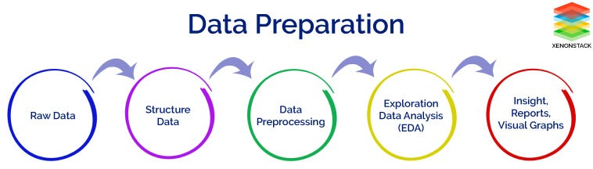
METHODOLOGY

Slide 5
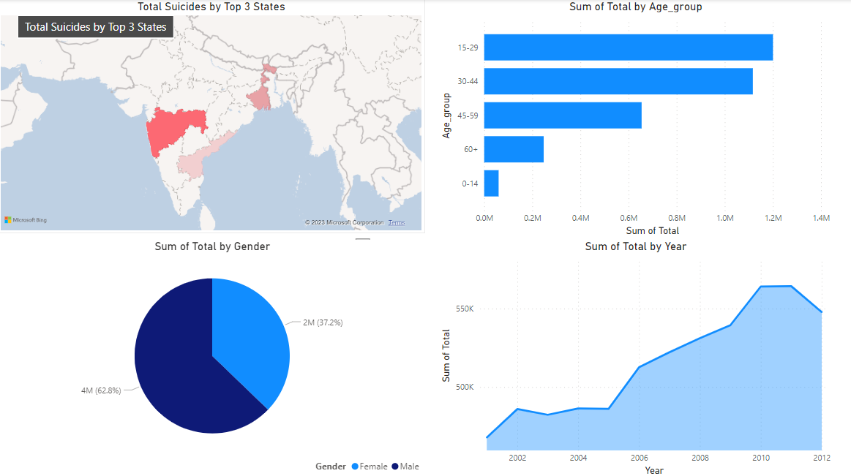
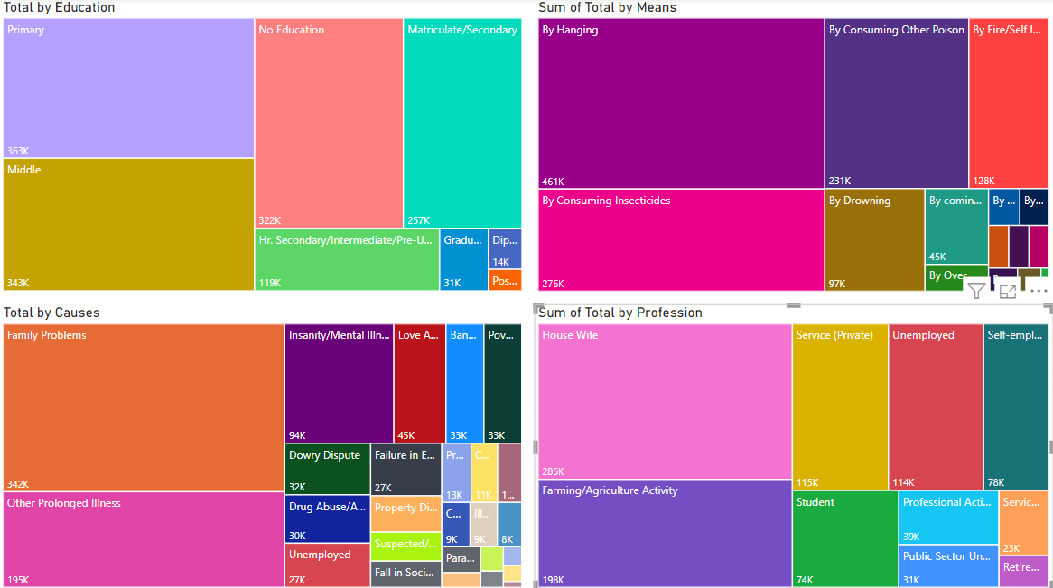
ANALYSIS AND RESULTS

Slide 6
INTERPRETATION
The most common causes of suicide:
Family problems
Mental illness and other health issues
Economic conditions
The most common professions of people who commit suicide are:
Housewife
Farmers
Students
The most common methods of committing suicide are:
By hanging
By consuming Insecticides and Poison
By Drowning
It has also been observed that males commit more suicides than females and the age group of 15-30 are more suicidal.

Slide 7
conclusions
Financial Counseling and Debt Management:
Offer financial counseling and education to help farmers manage debt and financial stress.
Develop programs that provide guidance on budgeting, debt reduction, and financial planning.
Reducing Access to Lethal Means:
Implementing measures to restrict access to lethal means of suicide, such as firearms or certain medications.
Promoting responsible storage and handling of firearms.
Mental Health Promotion:
Promoting mental health awareness and destigmatizing mental illness through public education campaigns.
Encouraging open discussions about mental health in schools, workplaces, and communities.
Reducing barriers to mental healthcare, such as cost or availability.

Slide 8
THANK YOU!

